Slide 1
HMM speech recognition, principles

Slide 2


Automatic speech-to-text recognition
Multidisciplinary field of work:
Mathematical modeling (= definition, use and training of models)
includes “machine learning”, “artificial intelligence”, …
Linguistics (= preparation of training data)
High performance computing (= training on >1000 hours of speech data)
Programming (= setting up experiments, integration of production systems)
Science (= measuring objective values, comparing, analyzing)

Slide 3
HMM-based speech-to-text recognition

Slide 4
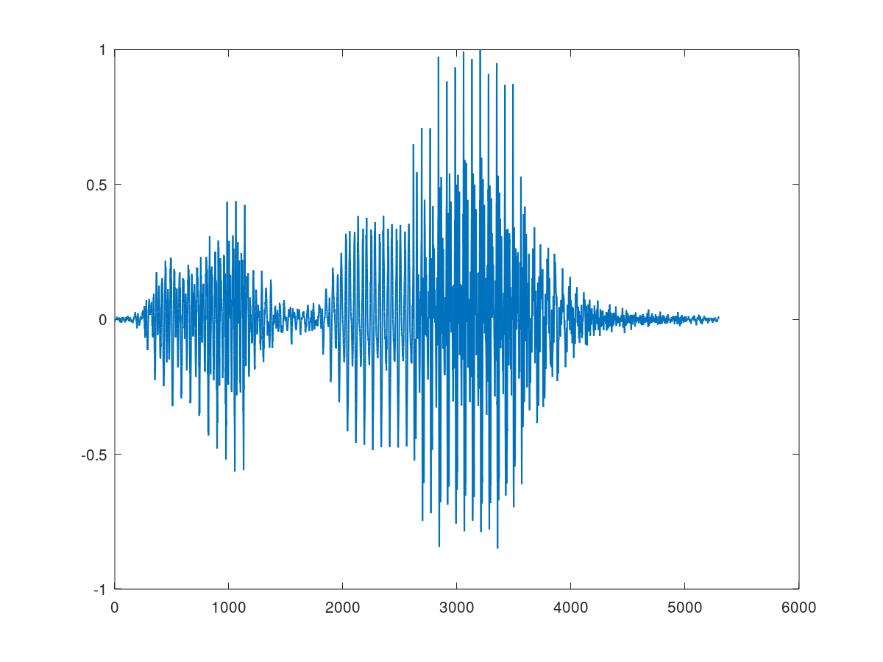
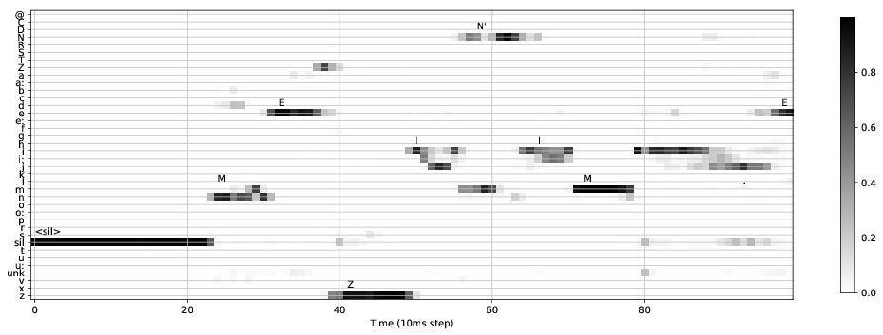
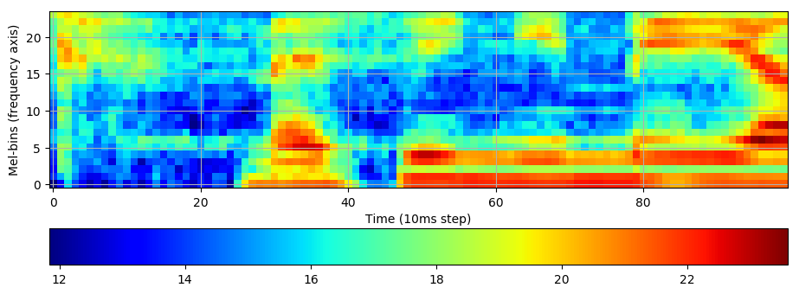
Recognition network
Voice activity detector
Feature
extractor
Acoustic model
Decoder
Lattice processing (one-best, n-best, …)
text

Slide 5
HMM model,
HMM = Hidden Markov Model (1st order Markov chain, current state depends only on previous state)
Topology: nodes, arcs (forward arcs or self-loops),
Trainable parameters: transition probabilities on arcs,
Acoustic units are modeled as sequence of states,
The self-loops allow to stay in the state.

Slide 6
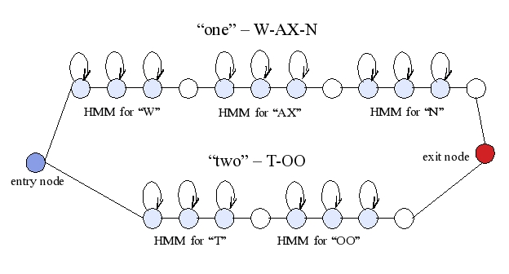
HMM model,
Word models are built by concatenating phoneme models,

Slide 7
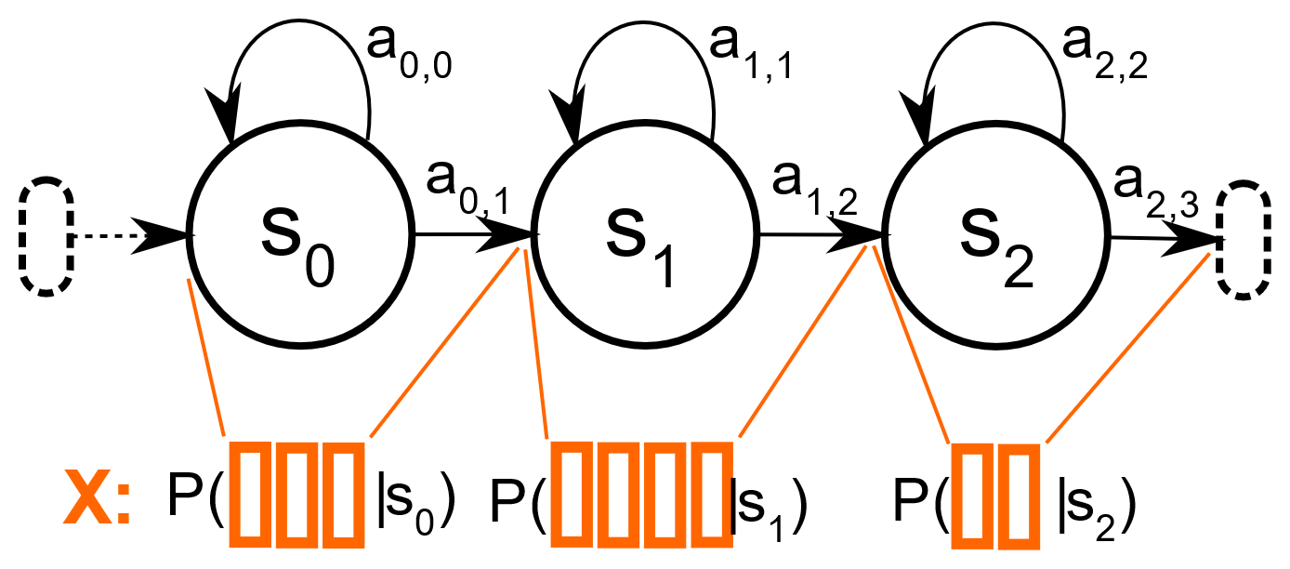
Acoustic scores in HMM model,
From acoustic model we get ‘likelihoods’ P(x_{t}|s_{i})
We don’t know if x_{t} is from s_{i}. We assume it is true, and P(x_{t}|s_{i}) is the ‘acoustic score’ telling how ‘likely’ x_{t} matches with the model of state s_{i}.

Slide 8
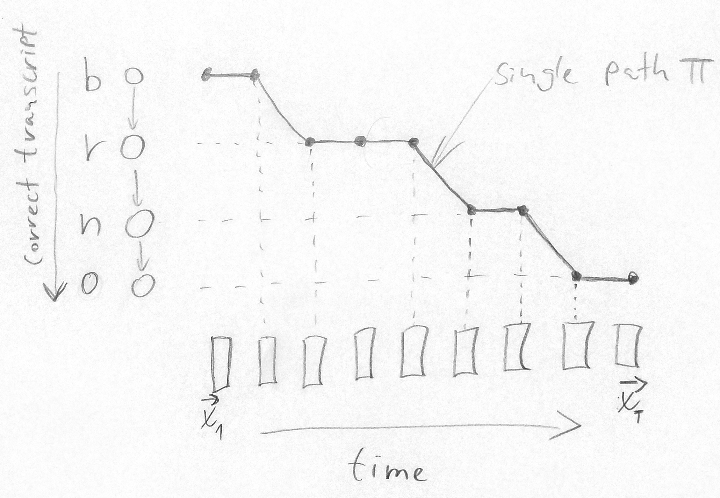
Forced alignment
As part of the training, we need to identify time-boundaries of HMM states in the speech. This is done by Forced alignment.
(where we know what the correct word-sequence is)
The alignment is a single path π:

Slide 9
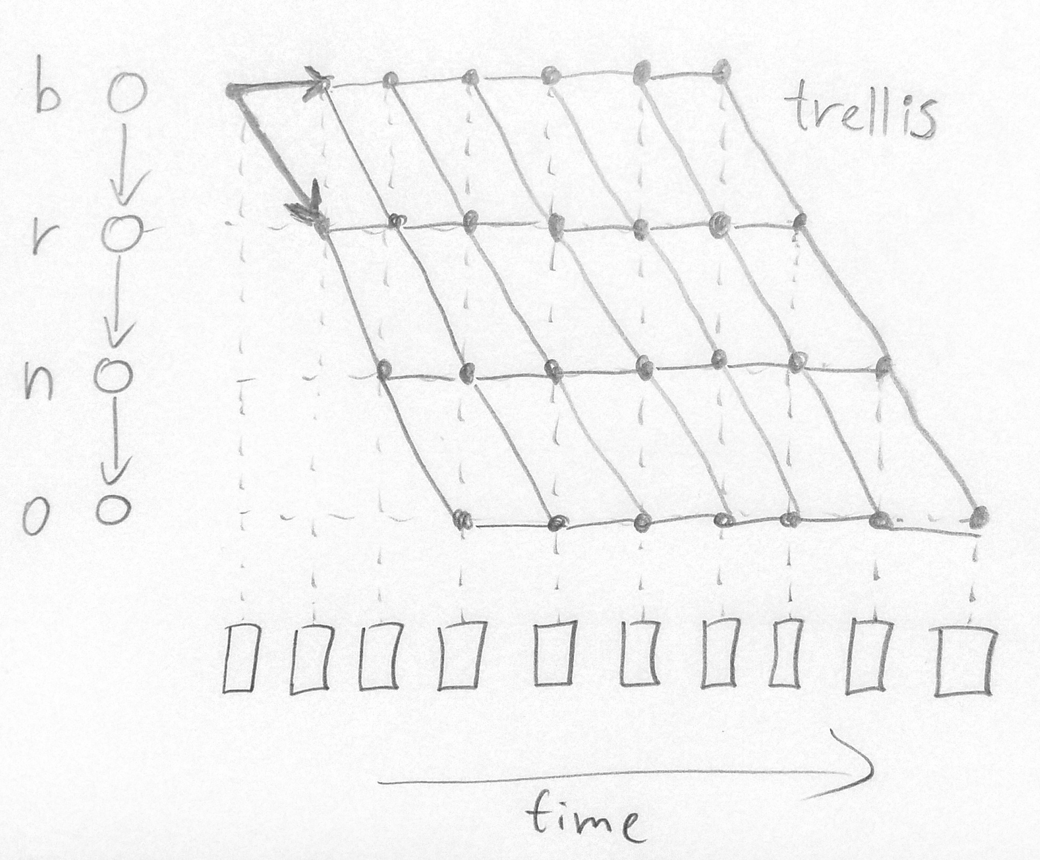
Forced alignment
As part of the training, we need to identify time-boundaries of HMM states in the speech. This is done by Forced alignment.
(where we know what the correct word-sequence is)
The alignment is a single path π.
The ‘search space’ of all possible paths is a trellis:

Slide 10
Forced alignment
As part of the training, we need to identify time-boundaries of HMM states in the speech. This is done by Forced alignment.
(where we know what the correct word-sequence is)
The alignment is a single path π.
The ‘search space’ of all possible paths is a trellis.
How do we find the alignment path?

Slide 11
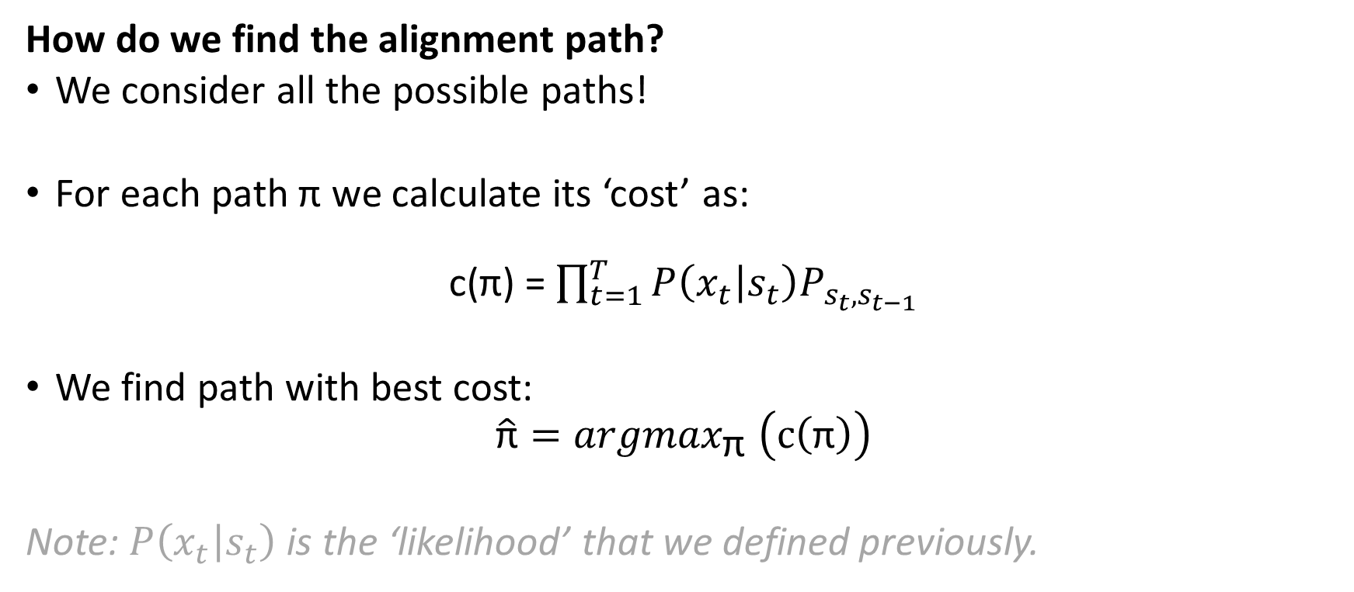
Forced alignment
How do we find the alignment path?
We consider all the possible paths!
For each path π we calculate its ‘cost’ as:
c(π) = $\prod_{t=1}^{T}{P\left(x_{t} | s_{t}\right)P_{ s_{t},s_{t−1}}}$
We find path with best cost:
$$\hat{\text{π}}={argmax}_{\text{π} }\left(c\left(\text{π}\right)\right)$$
Note: $P\left(x_{t} | s_{t}\right)$ is the ‘likelihood’ that we defined previously.

Slide 12
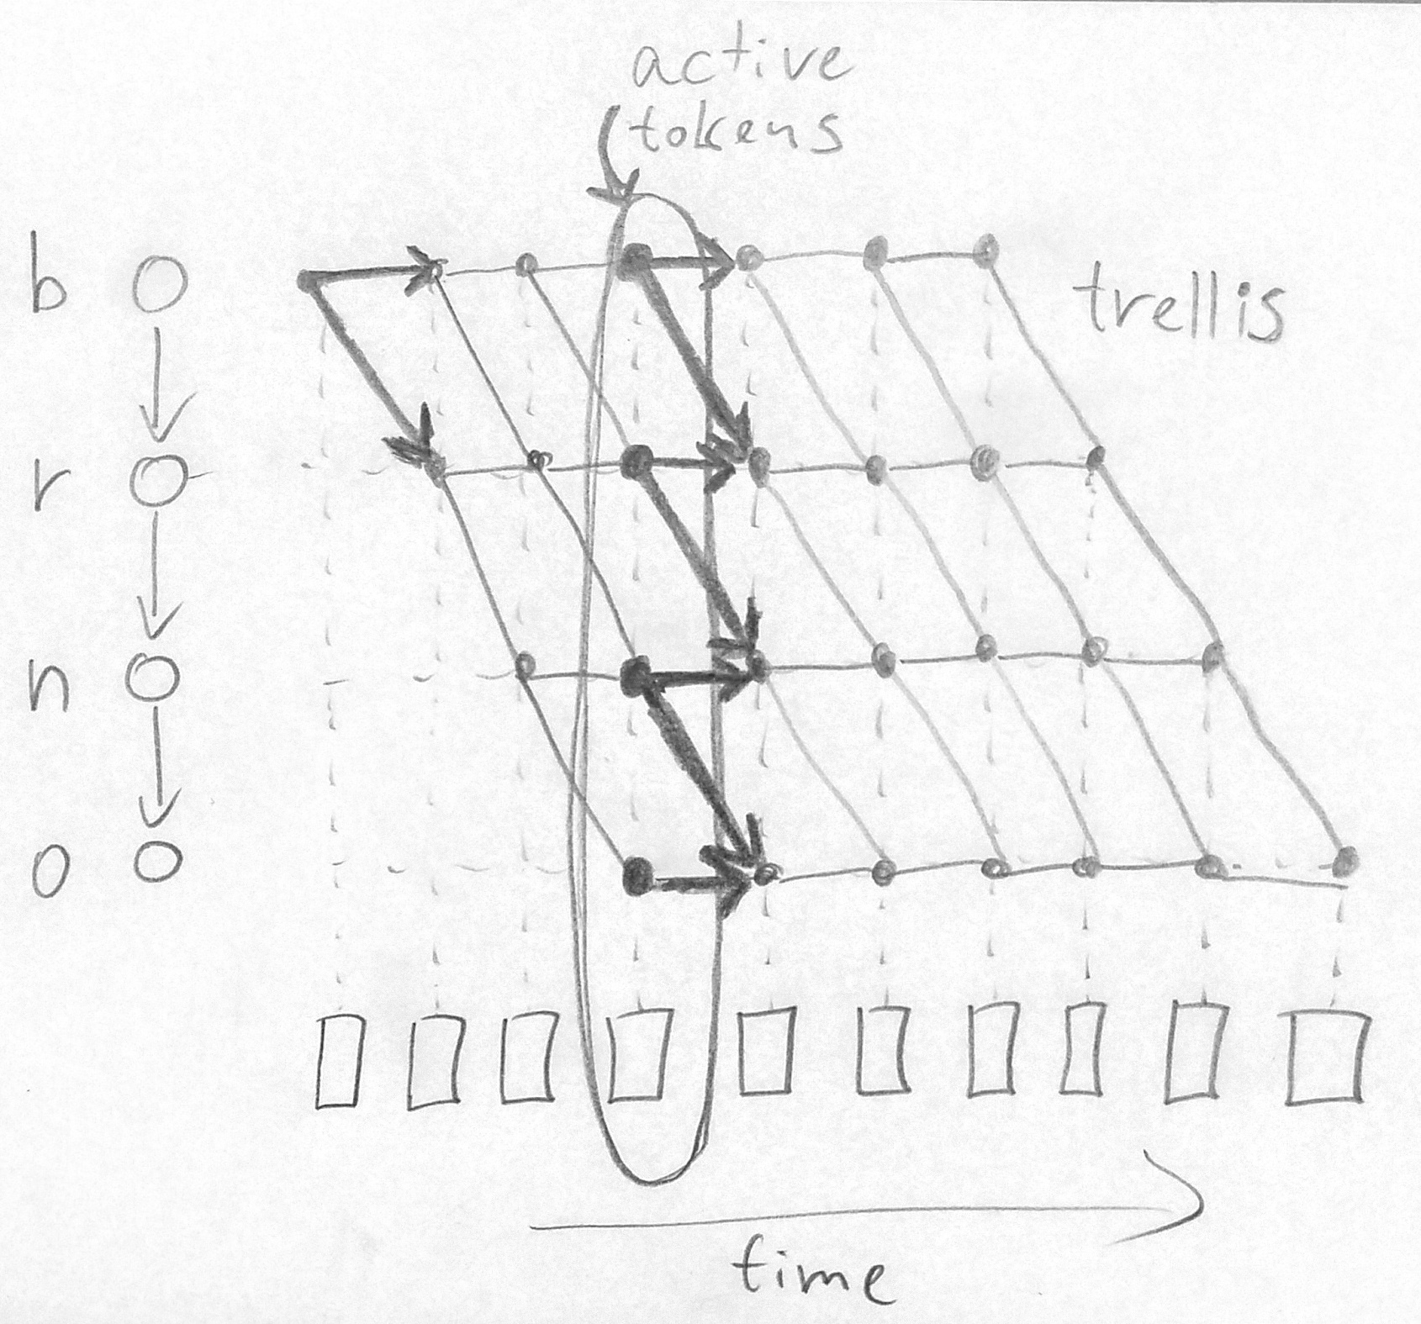
Forced alignment
How do we find the alignment path?
We can explore all paths efficiently by “token passing algorithm”:
The token carries the information about the ‘cost’ of its partial path and the trace-back history.
Viterbi search: when two arrows point to same state, only the path with best cost is preserved.
(The alignment is in the token that arrived to the end of the utterance)

Slide 13
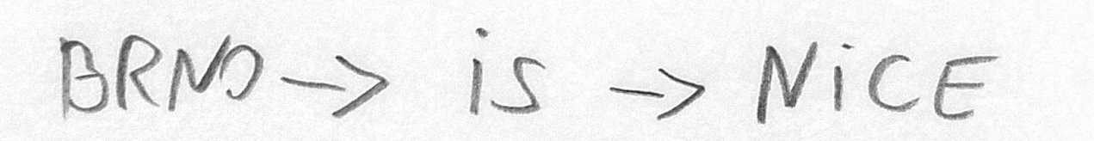
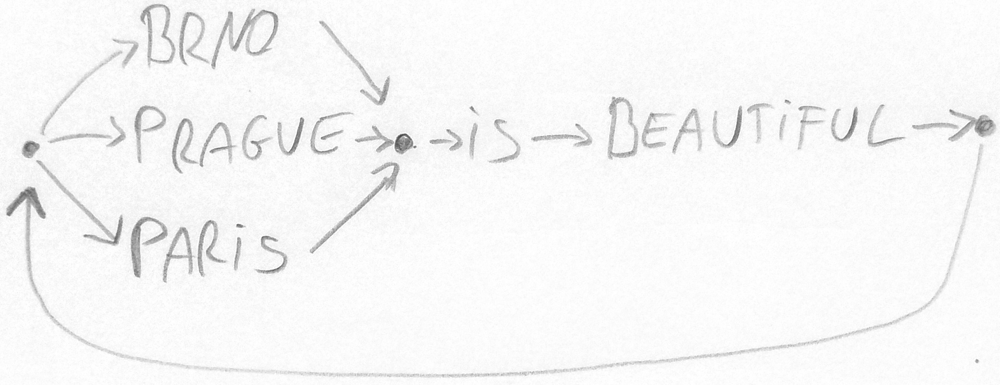
Speech-to-text recognition
Similar to ‘Forced alignment’ (it is using the same ‘decoder’ code, actually).
The difference is in the HMM model topology (recognition network).
Alignment: linear topology, no branching, no cycles
Decoding: graph with branching and cycles, and language model scores

Slide 14
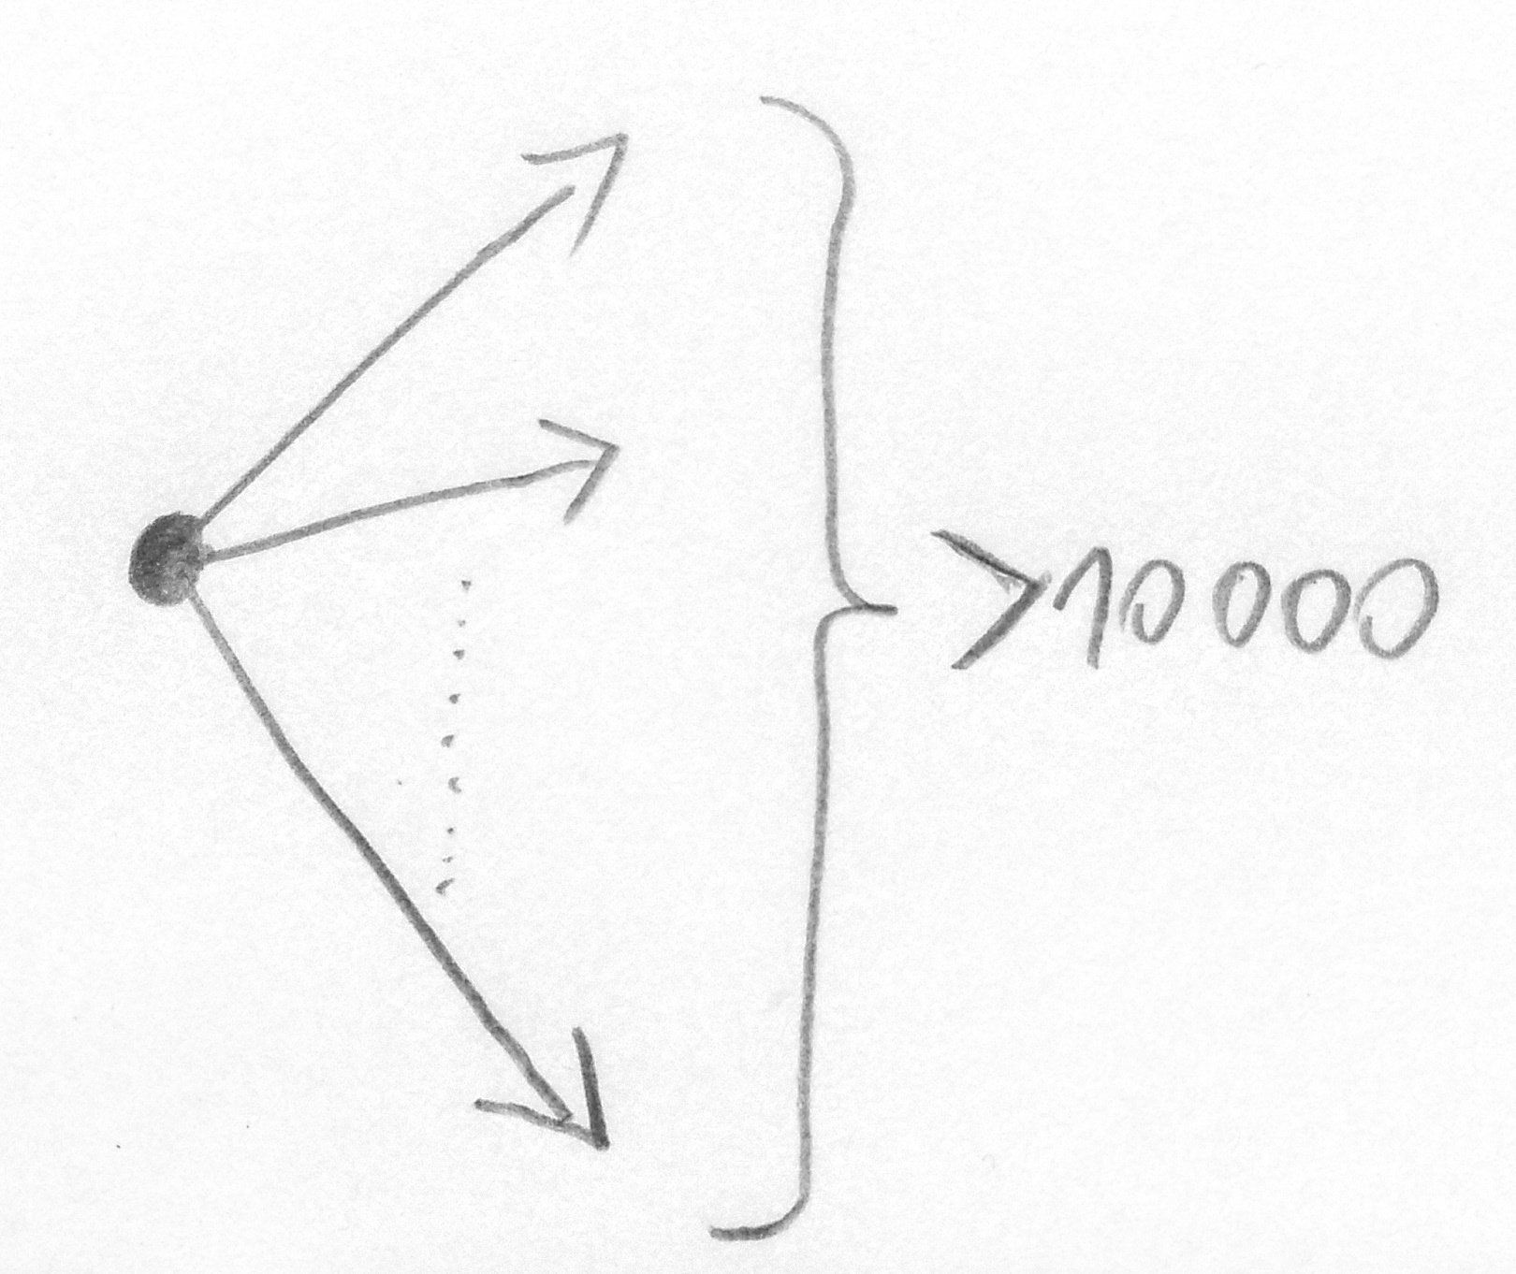
Speech-to-text recognition
Decoding: (graph with branching and cycles)
The graph is typically generated from language model which allow arbitrary sequencing of words (also the improbable ones).
Now, the search space is much larger. Exploring all the paths would be very slow ☹

Slide 15
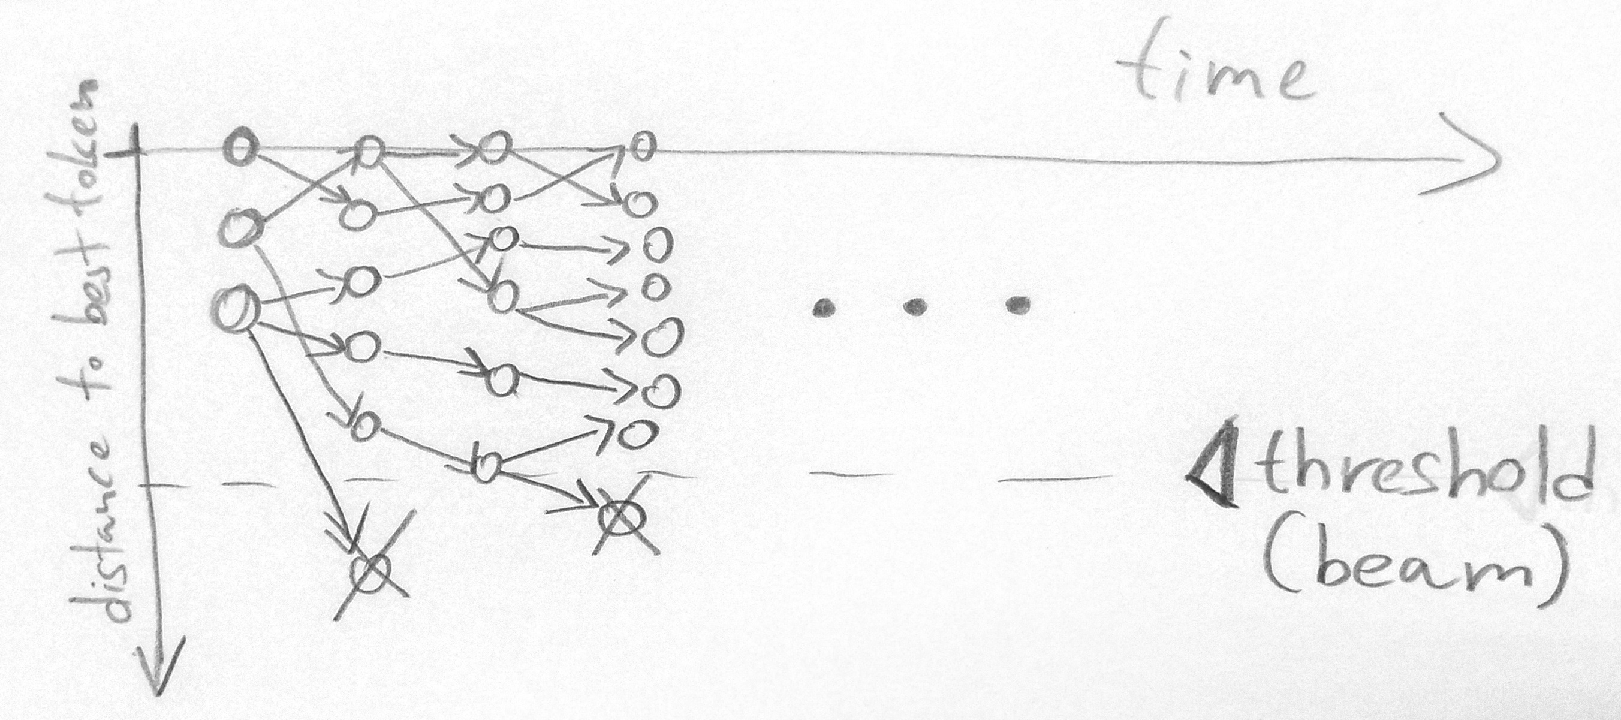
Speech-to-text recognition
Decoding: Exploring all the paths would be very slow.
The solution is ‘beam search’!!!
we discard tokens that have score too far from best token.
any of surviving tokens can become the best token!

Slide 16
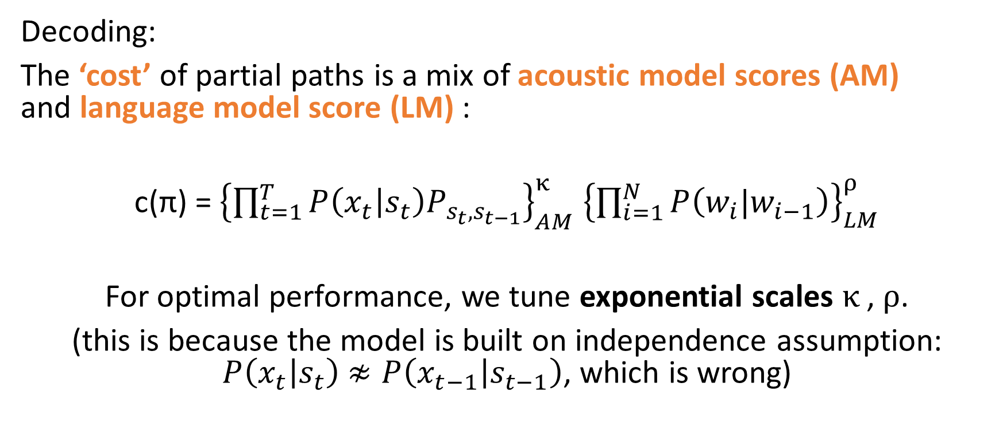
Speech-to-text recognition
Decoding:
The ‘cost’ of partial paths is a mix of acoustic model scores (AM) and language model score (LM) :
c(π) = ${\left\{\prod_{t=1}^{T}{P\left(x_{t} | s_{t}\right)P_{ s_{t},s_{t−1}}}\right\}}_{AM}^{κ} {\left\{\prod_{i=1}^{N}{P\left(w_{i}|w_{i−1}\right)}\right\}}_{LM}^{ρ}$
For optimal performance, we tune exponential scales $κ$, $ρ$.
(this is because the model is built on independence assumption: $P\left(x_{t} | s_{t}\right)$ $≉P\left(x_{t−1} | s_{t−1}\right)$, which is wrong)

Slide 17
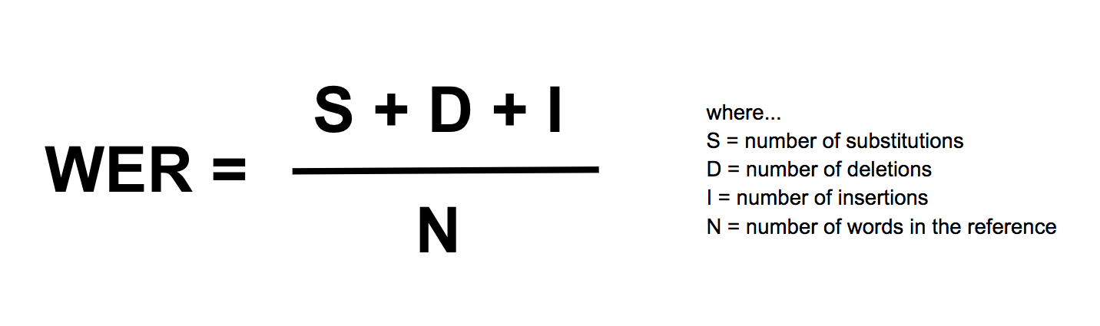
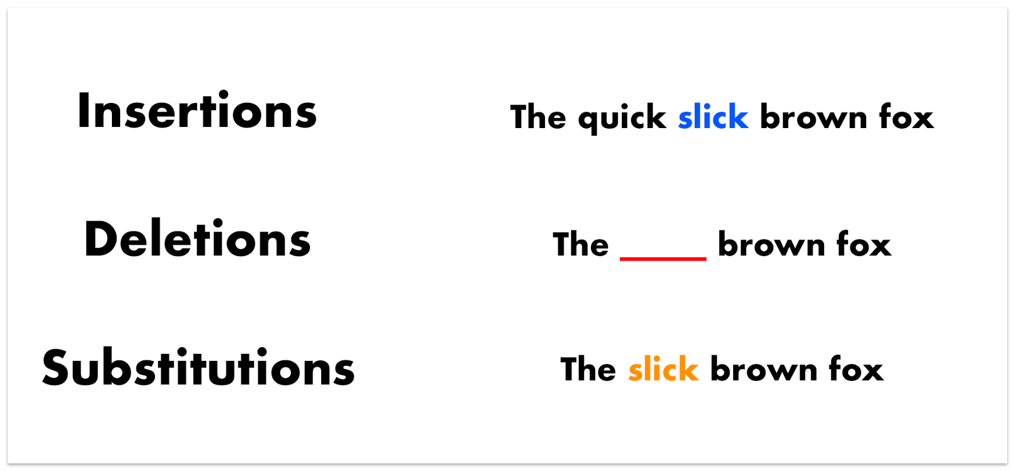
Evaluation by: Word Error Rate
Yes, the WER can be >100% !

Slide 18
Can you tell me how the Speech-to-text recognition works?

